Slide 1


.
PRACTICAL NO-2

Slide 2
1.STUDY BASIC SQL STATEMENTS
A . Basic Select Queries
Write an SQL query to retrieve all columns and rows from the Employees table.
B. Filtering Data Question:
Write an SQL query to find all employees whose last name is ‘doe'.
C. Sorting Data Question:
Write an SQL query to list all books from the Books table, ordered by publication year
in descending order.
D. Aggregating Data Question:
Write an SQL query to find the total number of orders in the Orders table

Slide 3
E. Grouping Data Question:
Write an SQL query to find the average salary of employees in each department. Assume you have the Employees table with columns Employee ID , FirstName , LastName , Salary, and DepartmentID.
F. Using DISTINCT Question:
Write an SQL query to list all unique job titles from the Employees table.
G. Using LIKE Question:
Write an SQL query to find all products from the Products table where the product name contains the word 'Laptop'.
H. Nested Sub queries Question:
Write an SQL query to find the names of employees who have a salary greater than the average salary of all employees.
Set Operations Question:
Write an SQL query to find the union of all product names from the Products table and all customer names from the Customers table.

Slide 4
objective
Data Query Language (DQL) is a subset of SQL (Structured Query Language) used specifically for querying and retrieving data from databases. The primary focus of DQL is to read and extract data based on specified criteria. It does not modify the data or the structure of the database; it only deals with retrieving and presenting data.

Slide 5
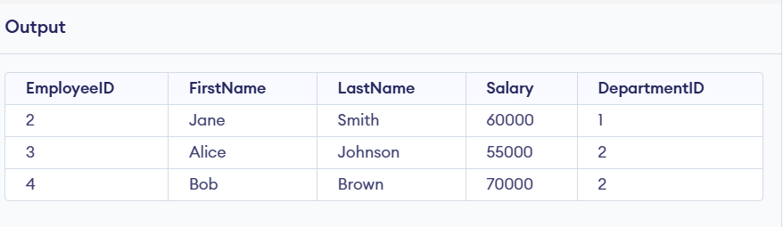
1. Write an SQL query to retrieve all columns and rows from the Employees table.
OUTPUT
QUERY
.
SELECT *
FROM Employees;

Slide 6


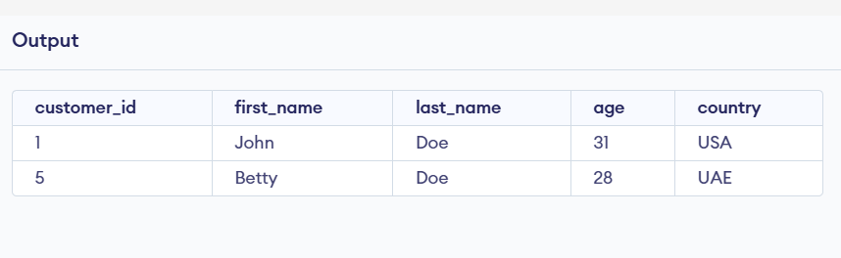
2. Write an SQL query to find all customers whose last name ‘doe'.
SELECT * FROM Customers WHERE last_Name = 'Doe';

Slide 7


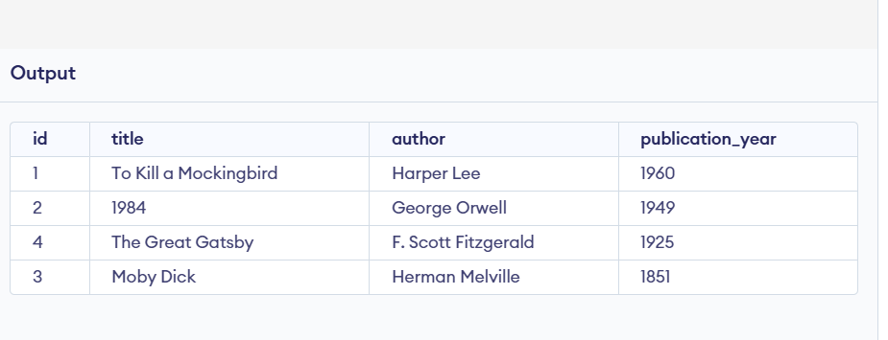
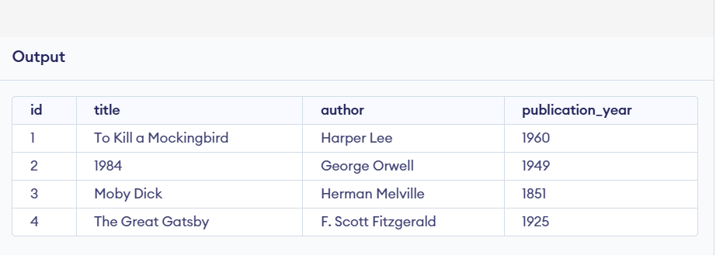

3. Write an SQL query to list all books from the Books table, ordered by publication year in descending order.
SELECT *
FROM Books
ORDER BY publication_year DESC;
Before apply the query
Computers have widespread applications across various industries and aspects of our lives.
Business
Accounting, inventory management, marketing, and customer relationship management
Education
Research, online learning platforms, and educational software
Healthcare
Diagnosis, treatment planning, medical imaging, and patient records management
Entertainment
Gaming, music streaming, video editing, and movie production

Slide 8




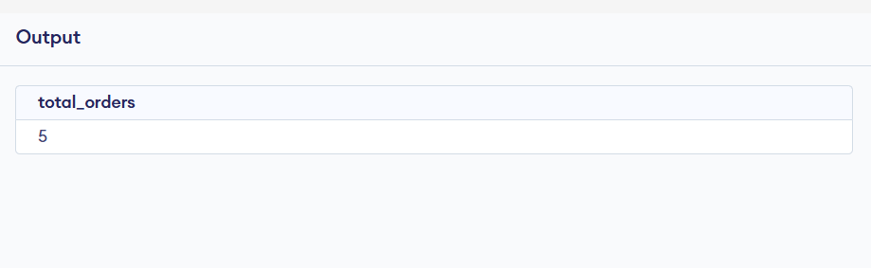

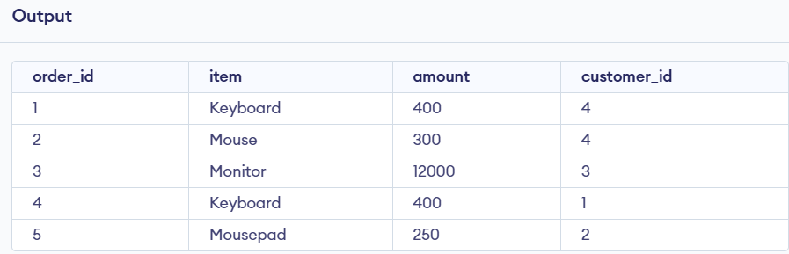

Impact of Computers on Society
4. Write an SQL query to find the total number of orders in the Orders table
Computers have profoundly impacted society, transforming how we live, work, and interact with each other.
Increased Efficiency
SELECT COUNT(*) AS total_orders FROM Orders;
Computers have automated tasks, freeing up human time and resources.
Before apply the query
Global Connectivity
Computers have facilitated communication and collaboration across the globe.
New Technologies
Computers have driven the development of new technologies, such as the internet, smartphones, and artificial intelligence.

Slide 9






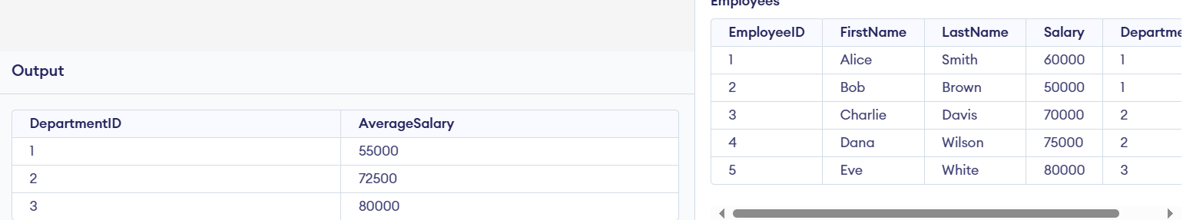
Advantages of Computers
5. Write an SQL query to find the average salary of employees in each department. Assume you have the Employees table with columns EmployeeID, FirstName, LastName, Salary, and DepartmentID.
Computers offer numerous advantages, contributing to progress and innovation.
Speed and Accuracy
Storage Capacity
SELECT DepartmentID, AVG(Salary)
AS average_salary FROM Employees GROUP BY DepartmentID;
Computers can perform complex calculations and tasks with remarkable speed and accuracy.
Computers can store vast amounts of data and information, making it easy to access and retrieve information.
Connectivity
User Friendliness
Computers facilitate communication and collaboration through networks and the internet.
Modern computer interfaces are designed to be user-friendly, making them accessible to a wide range of users.

Slide 10

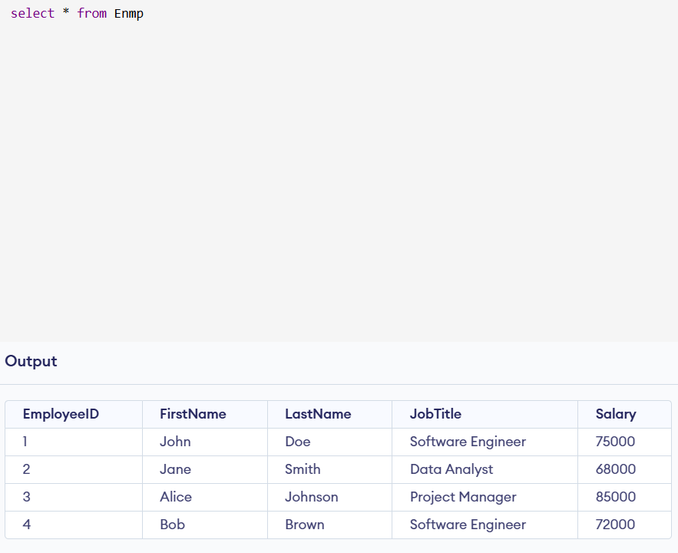
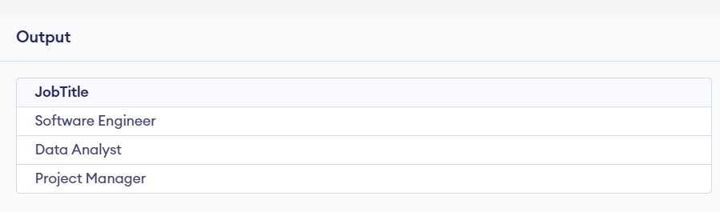
6. Write an SQL query to list all unique job titles from the Employees table.
Before apply the query
SELECT DISTINCT JobTitle FROM Enmp;
Conclusion
Computers have become indispensable tools in our modern world, revolutionizing various aspects of our lives. They continue to evolve and offer new possibilities, shaping the future of technology and society.

Slide 11
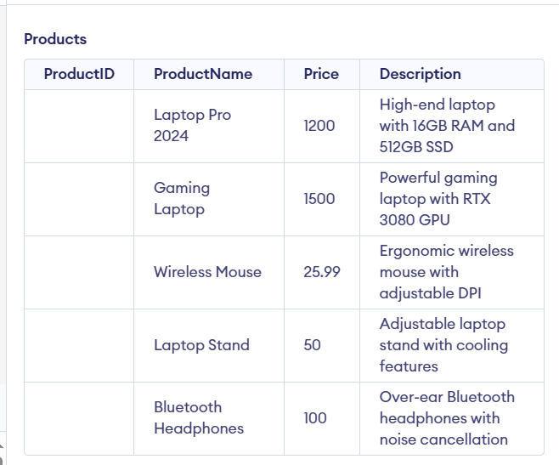
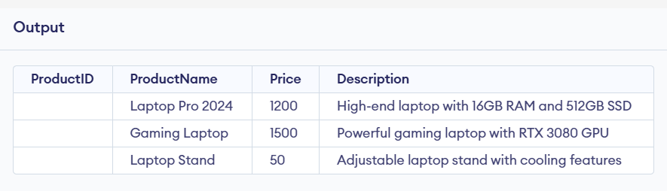
7. Write an SQL query to find all products from the Products table where the product name contains the word 'Laptop'.
Before apply the query
SELECT *FROM ProductsWHERE ProductName LIKE '%Laptop%';
Conclusion
Computers have become indispensable tools in our modern world, revolutionizing various aspects of our lives. They continue to evolve and offer new possibilities, shaping the future of technology and society.

Slide 12
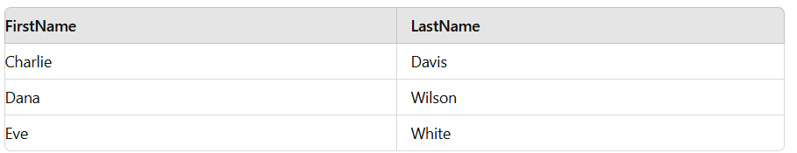
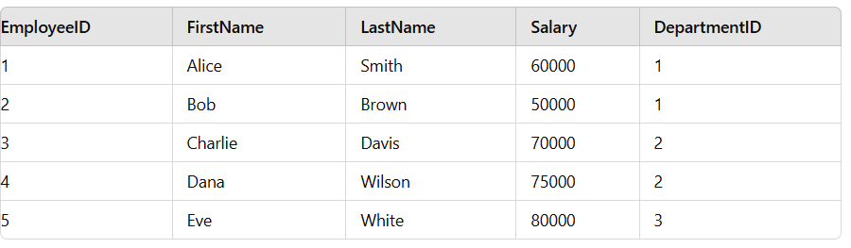
8. Write an SQL query to find the names of employees who have a salary greater than the average salary of all employees.
SELECT FirstName, LastName
FROM Employees
WHERE Salary > (SELECT AVG(Salary) FROM Employees);
Conclusion
Computers have become indispensable tools in our modern world, revolutionizing various aspects of our lives. They continue to evolve and offer new possibilities, shaping the future of technology and society.

Slide 13
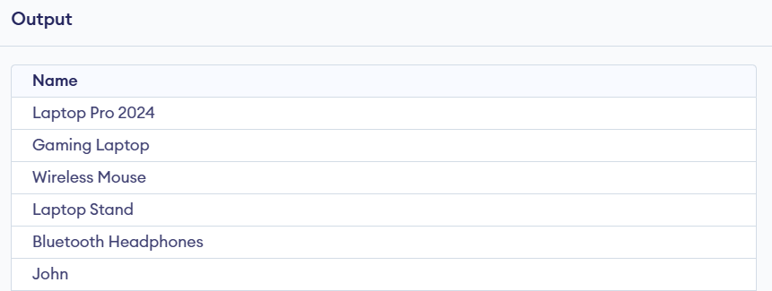
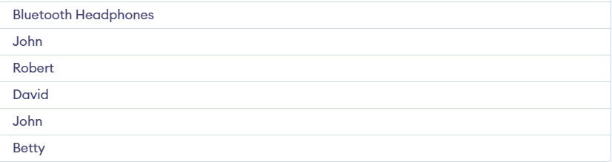
9. Write an SQL query to find the union of all product names from the Products table and all customer names from the Customers table.
SELECT ProductName AS Name FROM Products UNION
ALLSELECT first_name AS NameFROM Customers;
Conclusion
Computers have become indispensable tools in our modern world, revolutionizing various aspects of our lives. They continue to evolve and offer new possibilities, shaping the future of technology and society.

Slide 14
LEARNING OUTCOME 1.Learners will be able to understand and use the basic syntax and structure of SQL queries. 2. Learners will be proficient in retrieving data from one or more tables. 3.Learners will be able to use the WHERE clause to filter records based on specific conditions.
Conclusion
Computers have become indispensable tools in our modern world, revolutionizing various aspects of our lives. They continue to evolve and offer new possibilities, shaping the future of technology and society.

Slide 15
THANKYOU
Conclusion
Computers have become indispensable tools in our modern world, revolutionizing various aspects of our lives. They continue to evolve and offer new possibilities, shaping the future of technology and society.

